Slide 1
Java Basics 11
Guangjian Zhou

Slide 2
What do you understand by the term ‘Spring Boot’?
Java Spring Boot (Spring Boot) is a tool that makes developing web application and microservices with Spring Framework faster and easier through three core capabilities:
Autoconfiguration
An opinionated approach to configuration
The ability to create standalone applications

Slide 3
Explain the advantages of using Spring Boot for application development.
Advantages of Spring Boot:
It is very easy to develop Spring Based applications with Java or Groovy.
It reduces lots of development time and increases productivity.
It avoids writing lots of boilerplate Code, Annotations and XML Configuration.
It is very easy to integrate Spring Boot Application with its Spring Ecosystem like Spring JDBC, Spring ORM, Spring Data, Spring Security etc.
It follows “Opinionated Defaults Configuration” Approach to reduce Developer effort
It provides Embedded HTTP servers like Tomcat, Jetty etc. to develop and test our web applications very easily.
It provides CLI (Command Line Interface) tool to develop and test Spring Boot(Java or Groovy) Applications from command prompt very easily and quickly.
It provides lots of plugins to develop and test Spring Boot Applications very easily using Build Tools like Maven and Gradle
It provides lots of plugins to work with embedded and in-memory Databases very easily.

Slide 4
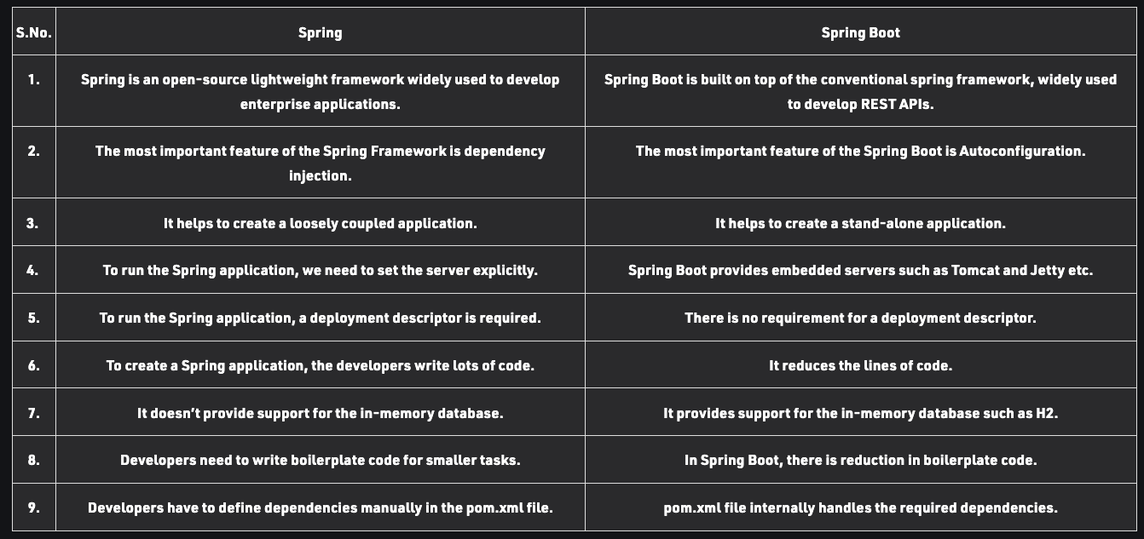
Differentiate between Spring and Spring Boot.

Slide 5
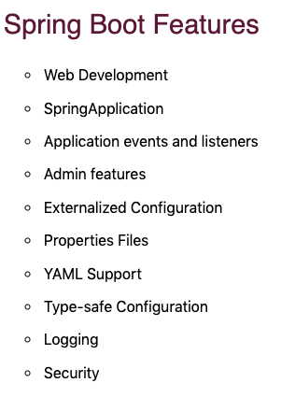
What are the features of Spring Boot?

Slide 6
What does @SpringBootApplication annotation do internally?
This annotation is used to mark the main class of a Spring Boot application. It encapsulates @SpringBootConfiguration, @EnableAutoConfiguration, and @ComponentScan annotations with their default attributes.

Slide 7
What are the effects of running Spring Boot Application as “Java Application”?

Slide 8
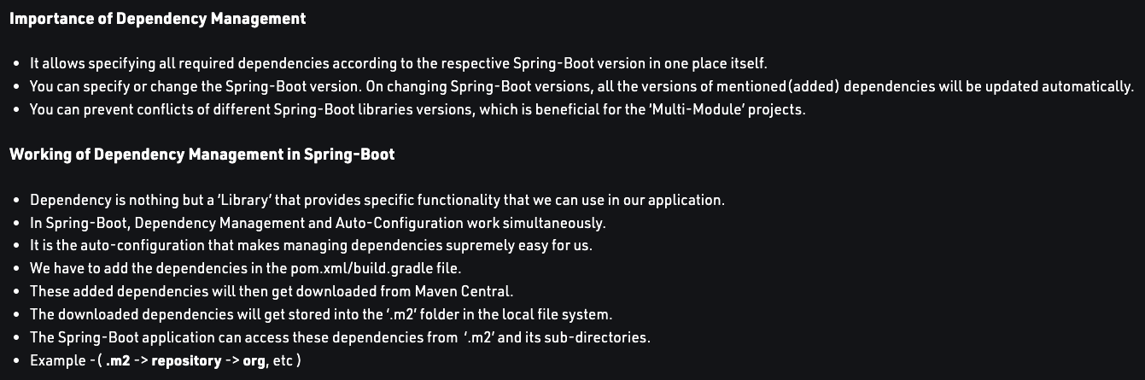
What is Spring Boot dependency management system?
Dependency Management is just a way of managing all the required dependencies in one place and efficiently making use of them.

Slide 9
What are the possible sources of external configuration?
You can use properties files, YAML files, environment variables, and command-line arguments to externalize configuration.

Slide 10
Can we change the default port of the embedded Tomcat server in Spring boot?
Changing Spring Boot Port in Tomcat using VM options Changing Spring Boot Port in Embedded Tomcat using Properties
Changing Spring Boot Tomcat Port Programmatically

Slide 11
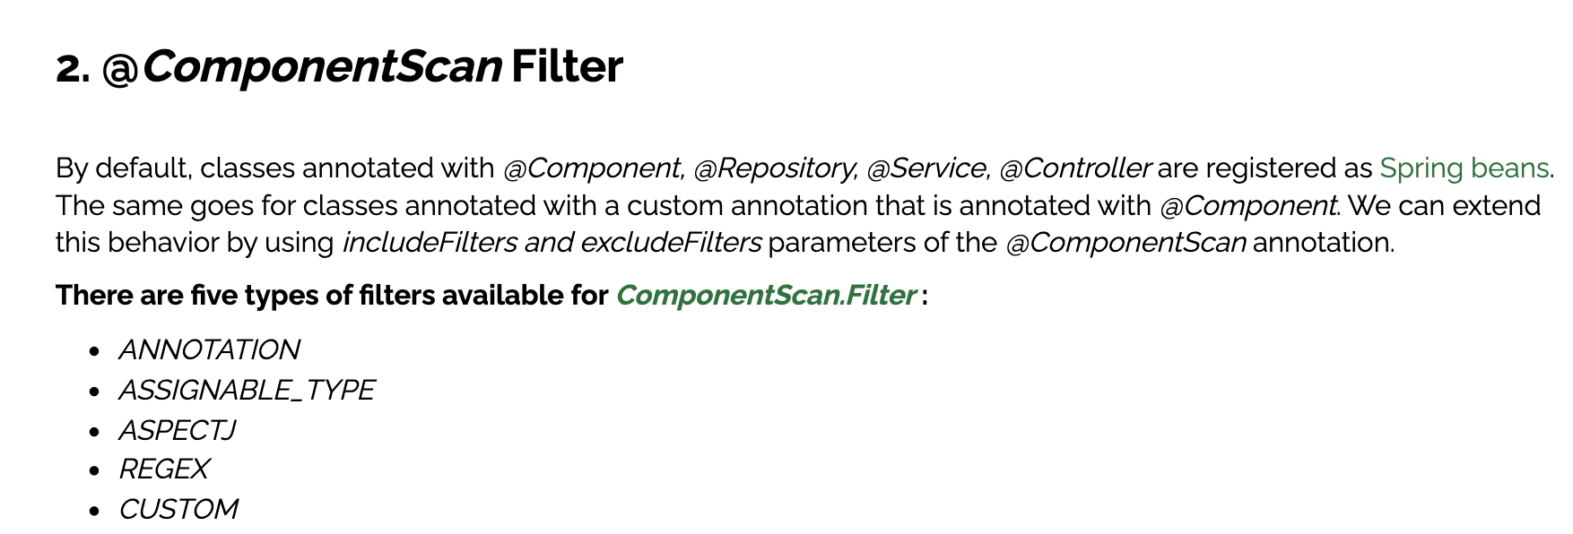
Can you tell how to exclude any package without using the basePackages filter?

Slide 12
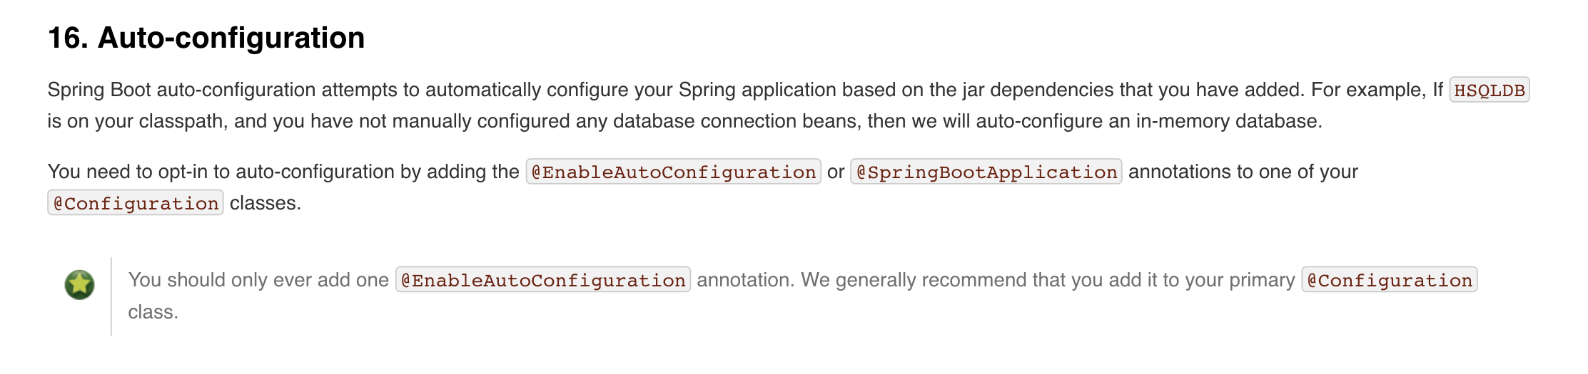
How to disable specific auto-configuration class?

